Slide 1

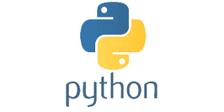
PYTHON
Lecture 3

Slide 2

QUIZ- Test Your Skills
What is the correct syntax of print statement in Python 2.x ?
print
print()
Print()
Print
Correct Answer: A

Slide 3
QUIZ- Test Your Skills
What is the correct syntax of print function in Python 3.x ?
print
print()
Print()
Print
Correct Answer: B

Slide 4
QUIZ- Test Your Skills
Python is case sensitive
False
True
Correct Answer: B

Slide 5
QUIZ- Test Your Skills
Python is a compiled language or interpreted language ?
Compiled Language
Interpreted Language
Both
None Of The Above
Correct Answer: C

Slide 6
QUIZ- Test Your Skills
A Python code is normally smaller than the corresponding C language code
True
False
Correct Answer: A

Slide 7
QUIZ- Test Your Skills
A Python code runs faster than the corresponding C language code
True
False
Correct Answer: B

Slide 8
QUIZ- Test Your Skills
What kind of code Python compiler produces ?
Machine Code
Secret Code
Source Code
Byte Code
Correct Answer: D

Slide 9
QUIZ- Test Your Skills
What is CPython ?
A Python Library
Name Of Python Framework
A Python language Implementation
None Of The Above
Correct Answer: C

Slide 10
QUIZ- Test Your Skills
In CPython , the bytecode is converted to machine instruction set by
PVM
VM
JVM
Bytecode Converter
Correct Answer: A

Slide 11
QUIZ- Test Your Skills
Python 3 is backward compatible with Python 2
True
False
Correct Answer: B

Slide 12
QUIZ- Test Your Skills
Support for Python 2 will end on
31-Jan-2019
1-Jan-2020
31-Dec-2018
31-Dec-2019
Correct Answer: B

Slide 13
QUIZ- Test Your Skills
Arrange the following in descending order of speed of execution
CPython , PyPy, C
PyPy, C, CPython
CPython , C, PyPy
C,PyPy,CPython
Correct Answer: D

Slide 14
QUIZ- Test Your Skills
Which implementation of Python contains JITC ?
CPython
PyPy
Jython
IronPython
Correct Answer: B

Slide 15
QUIZ- Test Your Skills
What is the output of 10/4 in Python 3?
2.0
2.5
2
None Of The Above
Correct Answer: B

Slide 16
QUIZ- Test Your Skills
What is the output of print “Python Rocks” in Python 3 ?
Python Rocks
Python
Syntax Error
None Of The Above
Correct Answer: C

Slide 17
QUIZ- Test Your Skills
Which of the following is not a Python IDE ?
PyCharm
Cutie Pie
Spyder
Visual Studio Code
Correct Answer: B

Slide 18
QUIZ- Test Your Skills
What is NumPy?
A library of Python for working with large and multidimensional arrays
A library of Python for Artificial Intelligence
A Python IDE
None of the above
Correct Answer: A

Slide 19
QUIZ- Test Your Skills
Python is a statically typed language
True
False
Correct Answer: B

Slide 20
Today’s Agenda
Developing First Python Code
What Is Python Shell ?
Using Python Shell
Writing Python Code Using Notepad
Running Python Code
How To View The Bytecode File ?

Slide 21
Two Ways Of Interacting With Python
In the last chapter, we have installed Python.
Now let’s start using it
We can use Python in two modes:
Interactive Mode
Script Mode

Slide 22
Two Ways Of Interacting With Python
In Interactive Mode, Python waits for us to enter command.
When we type the command, Python interpreter goes ahead and executes the command, and then it waits again for our next command.
In Script mode, Python interpreter runs a program from the source file.

Slide 23
The Interactive Mode
Python interpreter in interactive mode is commonly known as Python Shell.
To start the Python Shell enter the following command in the command prompt:
python
Doing this will activate the Python Shell and now we can use it for running python statements or commands

Slide 24
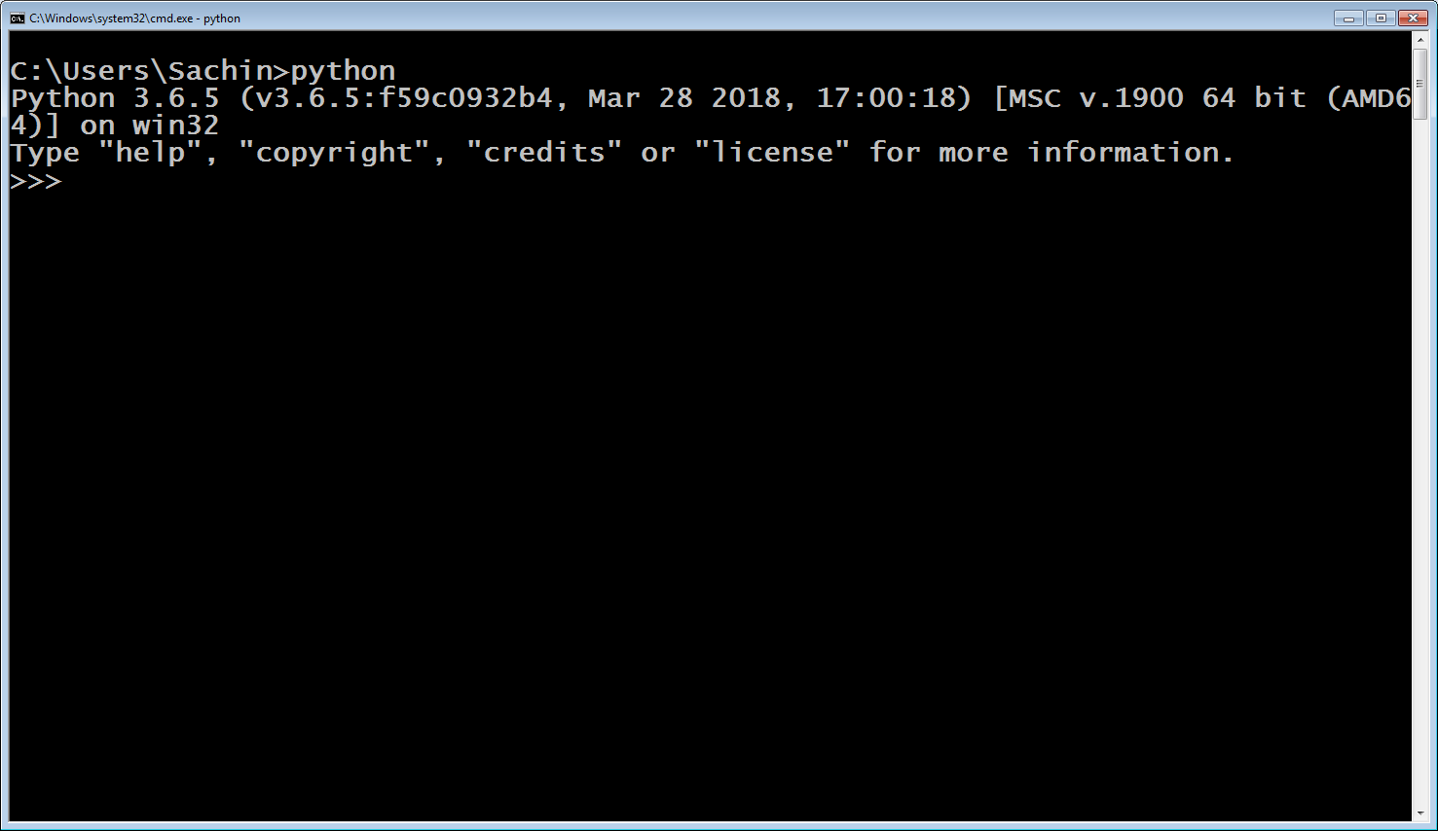
The Interactive Mode

Slide 25
The Interactive Mode
What we have seen on the previous slide is called Python Shell.
>>> is known as python prompt or prompt string, and it simply means that Python Shell is ready to accept our commands.
Python Shell allows us to type Python code and see the result immediately.

Slide 26
The Interactive Mode
In technical jargon this is also known as REPL which stands for Read-Eval-Print-Loop.
Whenever we hear REPL we should think of an environment which allows us to quickly test code snippets and see results immediately, just like a Calculator.
Some examples of commands / code snippets to be run on shell are shown in the next slide

Slide 27
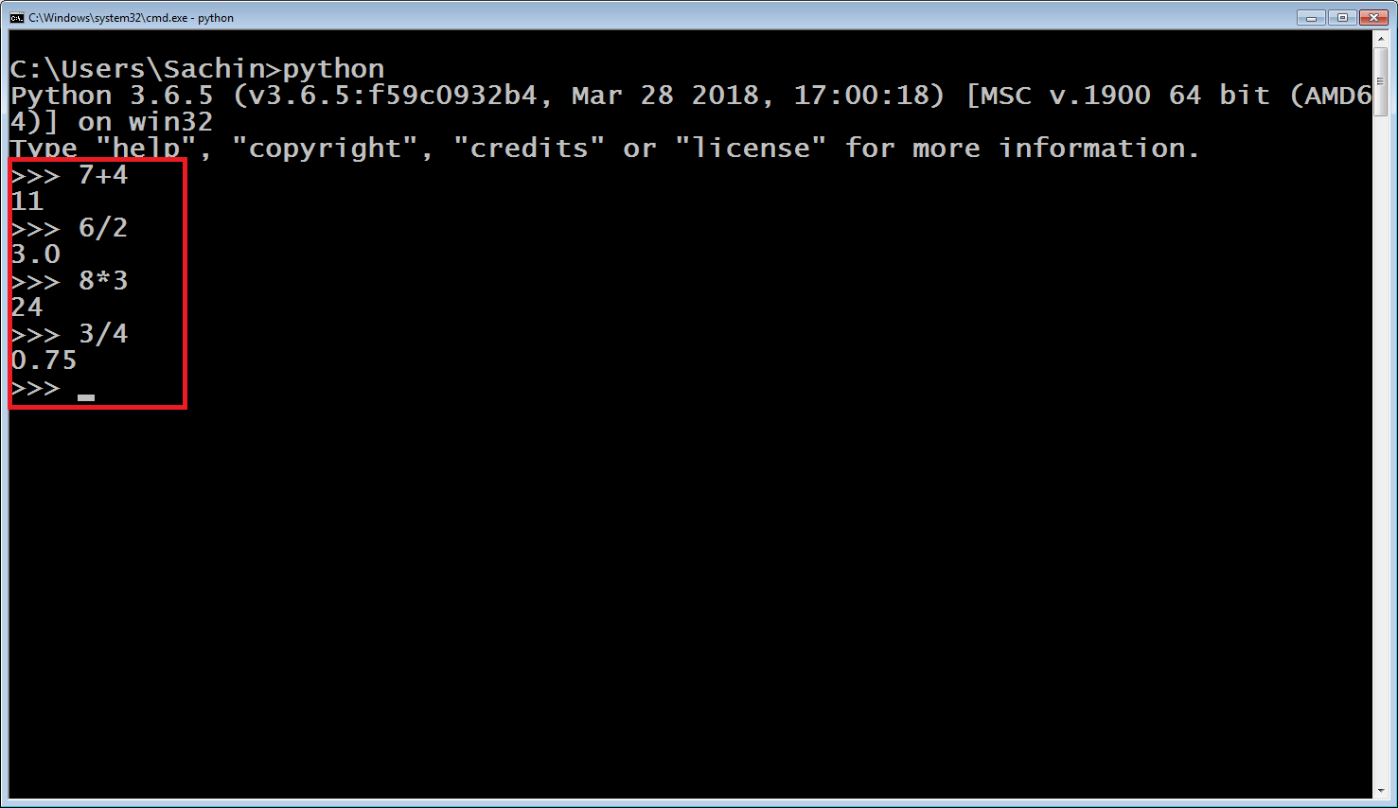
The Interactive Mode

Slide 28

The Interactive Mode
Not only mathematical calculations , we also can run some basic python commands on Python Shell
For example: Type the following command:
print(“Hello Bhopal”)
And you will get the text displayed on the Shell

Slide 29
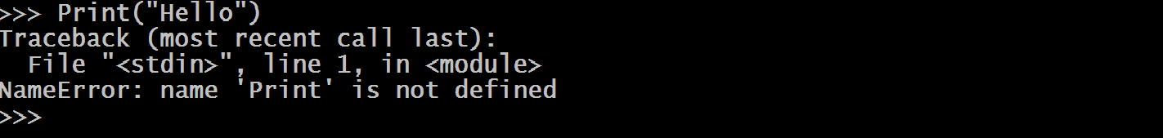
The Interactive Mode
We must remember that Python is also a case sensitive language like C or C++ .
So the function names must appear in lower case , otherwise Python generates Syntax Error , as shown below

Slide 30
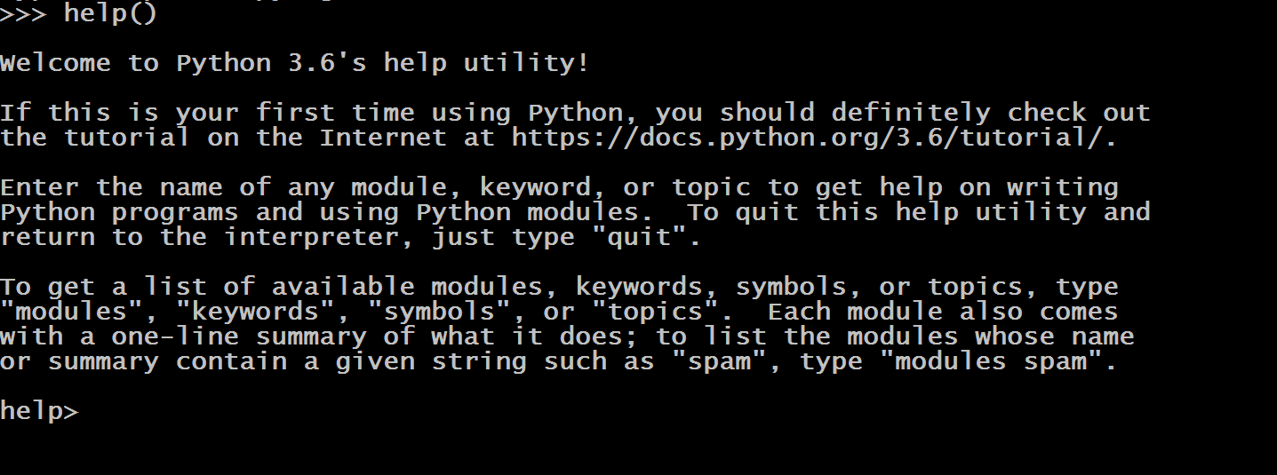
Getting Help From Shell
We can also use help on Shell for getting information on Python topics.
To do this we need to type help( ) on the prompt string on the Shell

Slide 31
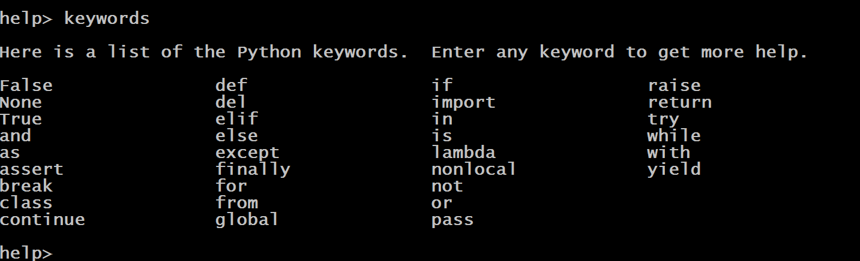
Getting Help From Shell
Now we get help on various Python topics .
For example to get a list of all the available keywords in Python , we can write the command “keywords”

Slide 32
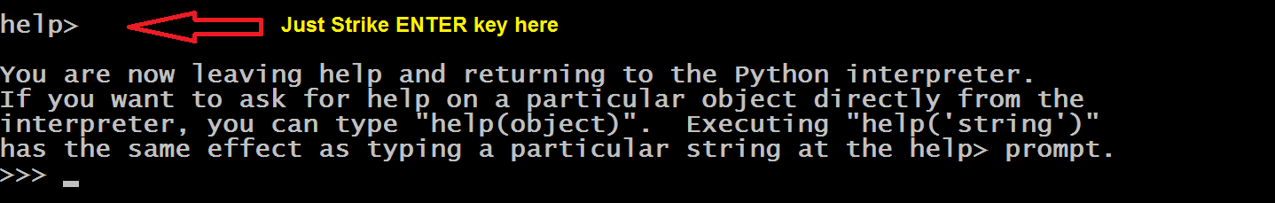
Quitting Help
To come out of help mode , we just have to strike ENTER key on the prompt

Slide 33
Quitting Shell
To come out of Python Shell , we have to type the command exit( ) or quit( ) on the prompt string

Slide 34
The Script Mode
Python Shell is great for testing small chunks of code but there is one problem - the statements we enter in the Python shell are not saved anywhere.
So if we want to execute same set of statements multiple times we will have to write them multiple times which is a difficult task.
In this case it is better to write the code in a File , Save it and then Run it
This is called Script Mode

Slide 35
The Script Mode
In this mode we take following steps for developing and running a Python code:
Write the source code
Compile it ( Generation of bytecode )
Run it ( Execution of the bytecode )
As discussed previously , step 2 is hidden from the programmer and is internally performed by Python itself , so we just have to perform step 1 and step 3

Slide 36
The Script Mode
For this do the following:
Create a directory by any name at any location . I am creating it by the name of “My Python Codes” in D:\ drive .
Open notepad and type the code as shown in the next slide in the file.

Slide 37
The Script Mode
print("Hello User")
print("Python Rocks")

Slide 38
The Script Mode
Now save this file by the name firstcode.py in the folder “My Python Codes” in D:\ drive .
Remember the file can have any name but the extension must compulsorily be .py
Now open the command prompt , move to the folder My Python Codes and type the following command:
python firstcode.py
Here “python” is the name of Python’s interpreter which will run the program firstcode.py

Slide 39
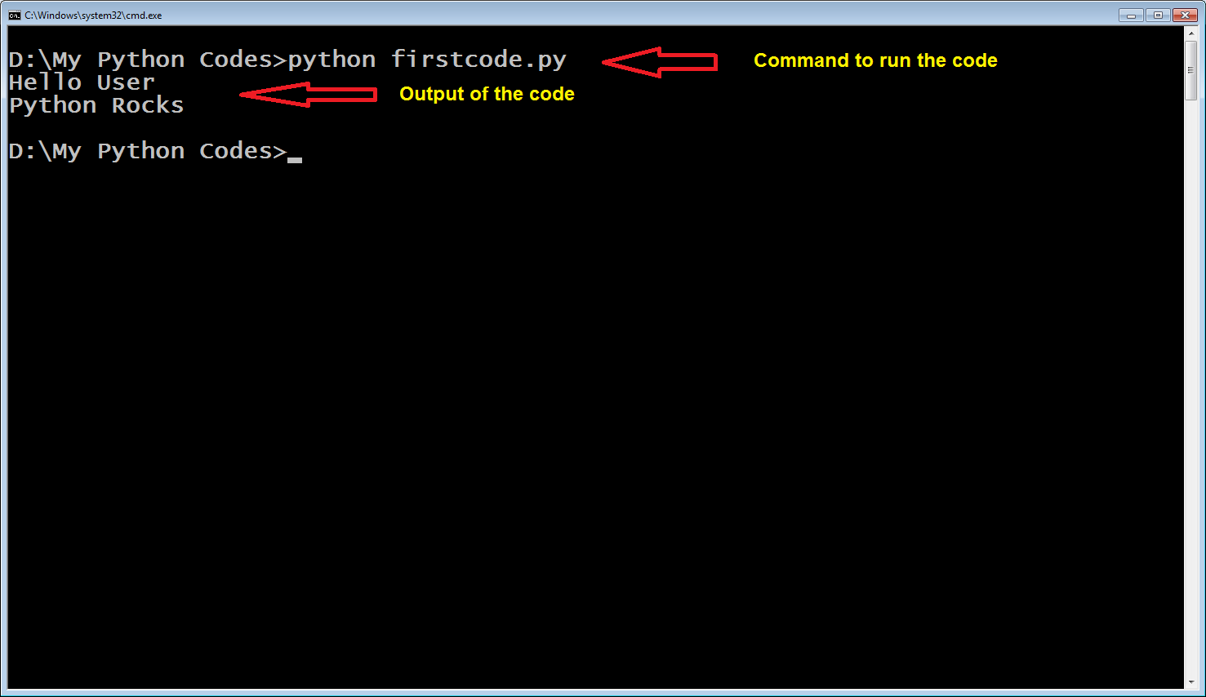
The Script Mode

Slide 40
What Happened In Background?
When a Python program executes, a bytecode compiler translates source code into bytecode.
This bytecode is stored in RAM and not visible to us.
After the bytecode is produced, it is then processed by the PVM (Python Virtual Machine a.k.a Python Runtime or Python interpreter).
So the Python compiler produces bytecode in bulk while the Python interpreter inside PVM performs line-by-line execution of the bytecode.

Slide 41
What Happened In Background?
So in our case the following sequence of events will take place:
Programmer writes the source code by the name firstcode.py
Then he/she runs the program using the command:
python firstcode.py
The Python compiler internally generates the bytecode file called as firstcode.pyc
Then the Python interpreter gets invoked and it reads this bytecode file and converts each bytecode instruction to the underlying operating system’s instruction set and sends it for execution to the CPU
Finally the programmer then sees the output

Slide 42
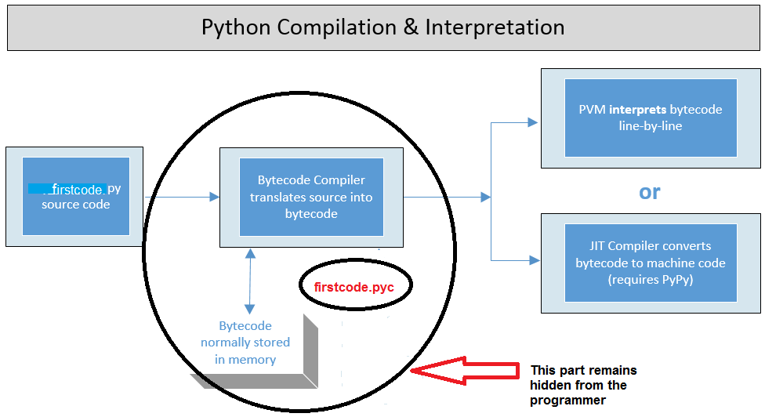
What Happened In Background?

Slide 43
Can We See The Bytecode File ?
Yes, we can force Python to save the bytecode file for us so that we view it.
To do this we need to write the following command
python –m py_compile firstcode.py
In the above command , we are using the switch –m , which is called Module.
Module in Python are just like header files of C/C++ language as it contains functions ,classes and global variables

Slide 44
Can We See The Bytecode File ?
The module name in this command is py_compile and it generates .pyc file for the .py file.
Now the Python compiler creates a separate folder called __pycache__ for storing this bytecode file
The name of the bytecode file is based on the Python implementation we are using
Since we are using Cpython , so in our case the file name will be firstcode.cpython-36.pyc

Slide 45
Can We See The Bytecode File ?
After we have created the .pyc file , the next step is to interpret it using Python interpreter
The command for this will be:
python __pycache__\firstcode.cpython-36.pyc
When we will run the above command the Python interpreter inside PVM will be invoked and will run the bytecode instructions inside the firstcode.cpython-36.pyc file

Slide 46
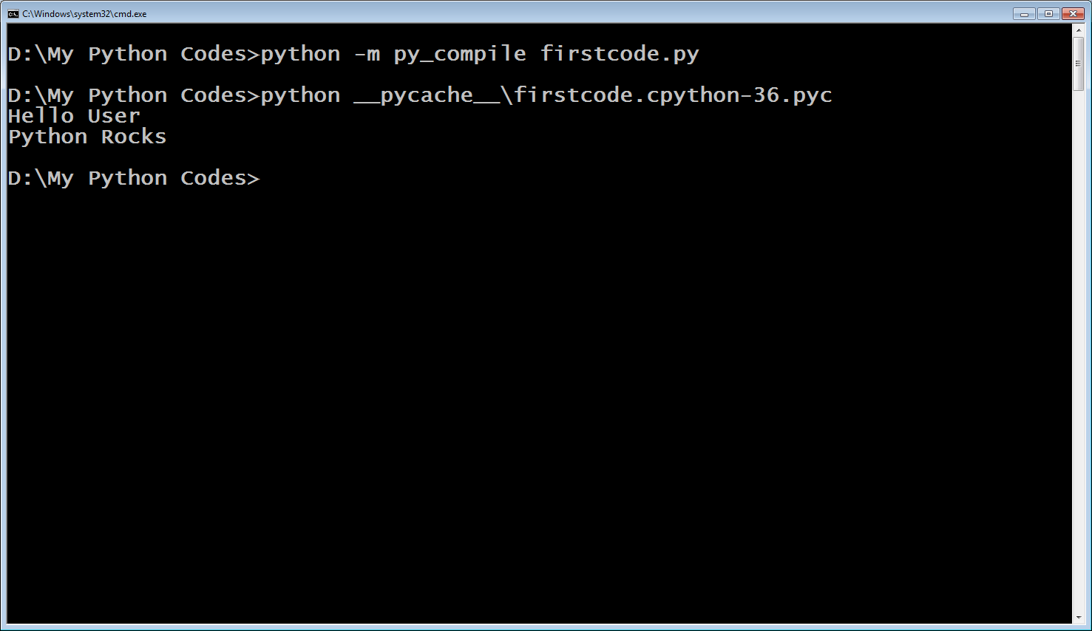
Can We See The Bytecode File ?

